Slide 1
MAT 350 Engineering Mathematics
FALL 2025
Lecture -1
Introduction to ODEs
Mohammad Sahadet Hossain, PhD
Professor
Department of Mathematics and Physics
North South University
mohammad.hossain@northsouth.edu

Slide 2
Why should we learn
Ordinary Differential Equations (ODEs) ?

Slide 3

The BIG Picture of Differential Equations
Motion of a Satellite ISS on the earth surface

Slide 4
The BIG Picture of Differential Equations
Orientation of Satellite ISS on Earth

Slide 5
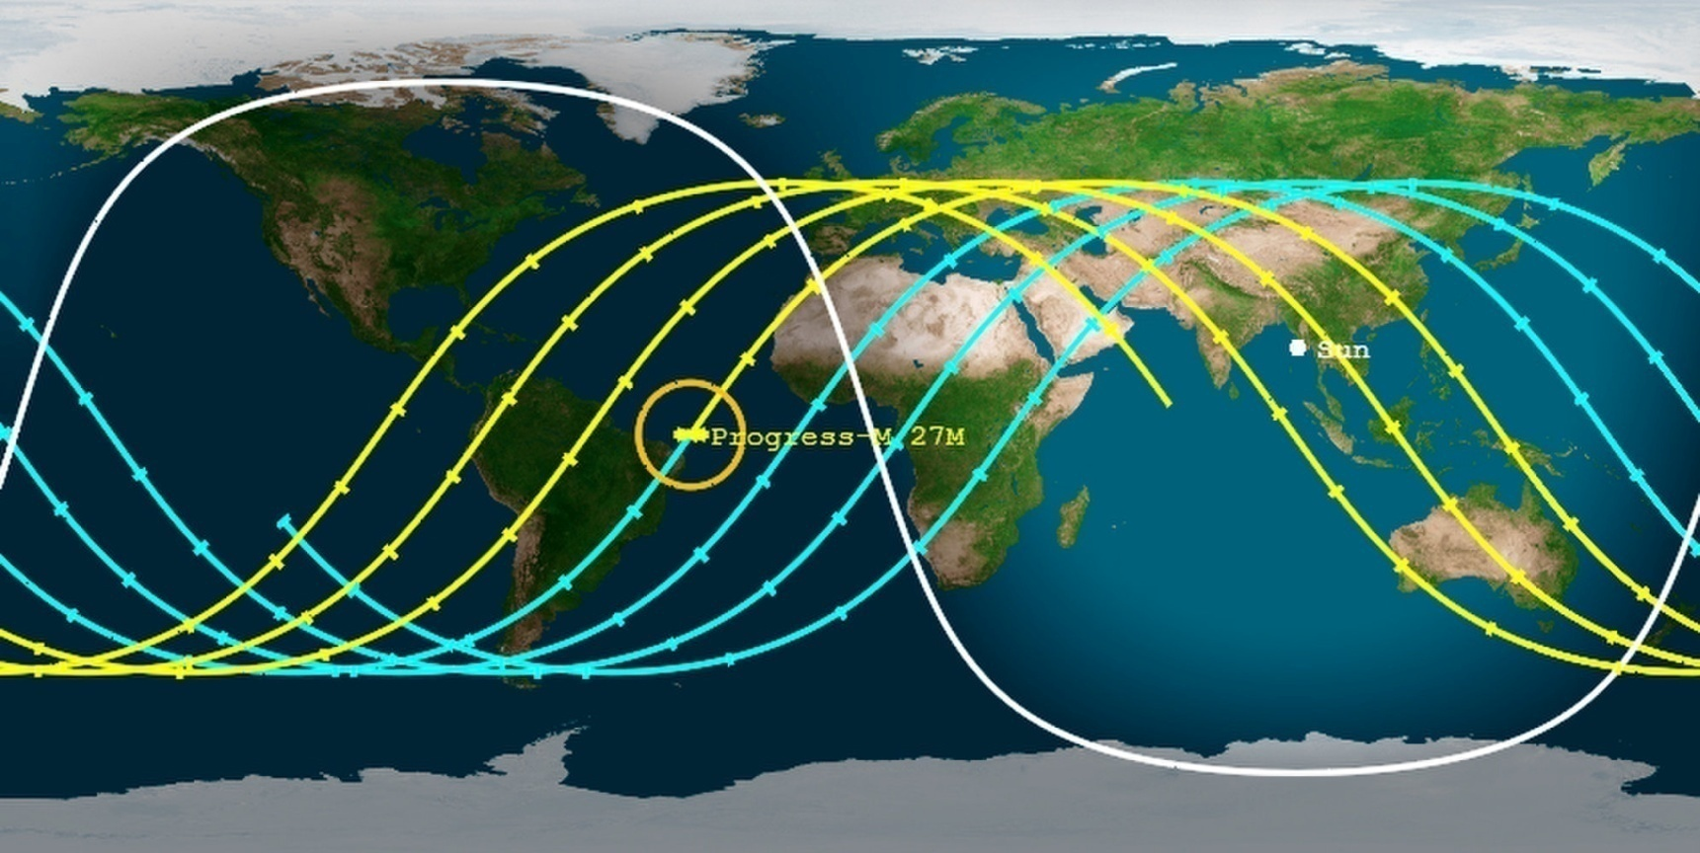
The BIG Picture of Differential Equations
Ground Track View of ISS orientation

Slide 6

The BIG Picture of Differential Equations
Path of a guided Missile

Slide 7
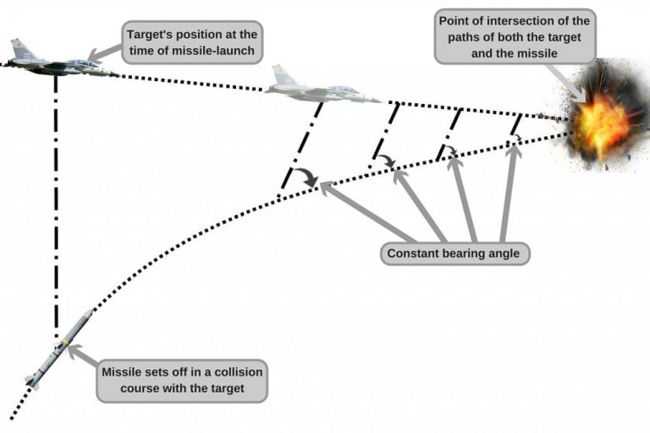
The BIG Picture of Differential Equations
Path of a guided Missile

Slide 8
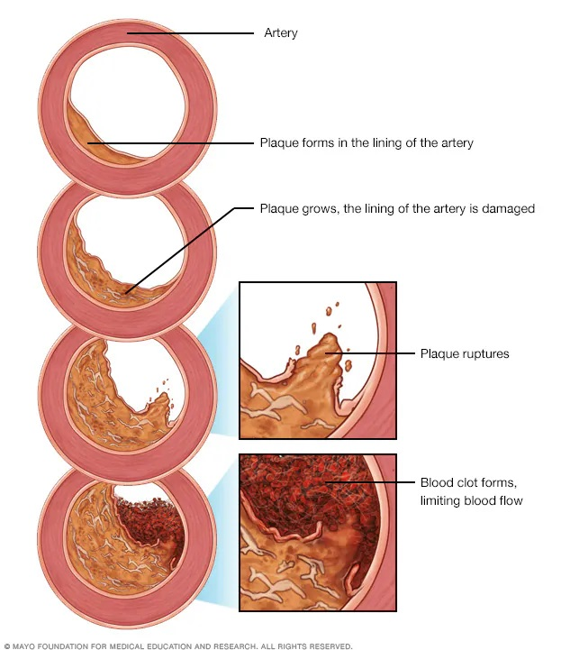
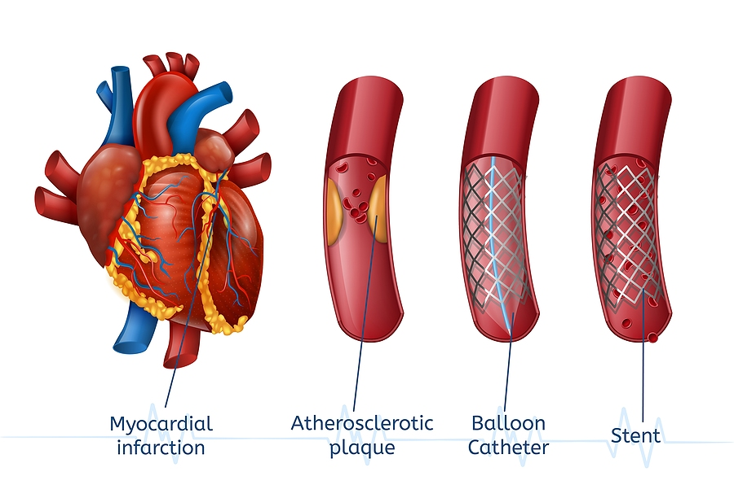
The BIG Picture of Differential Equations
Blood clot inside artery and Stent

Slide 9
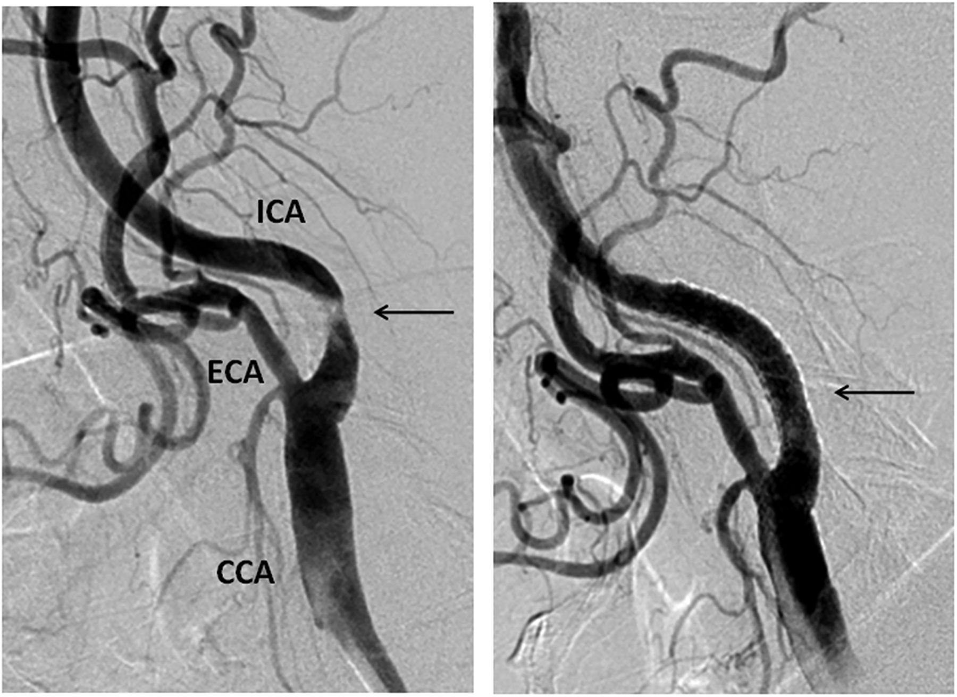
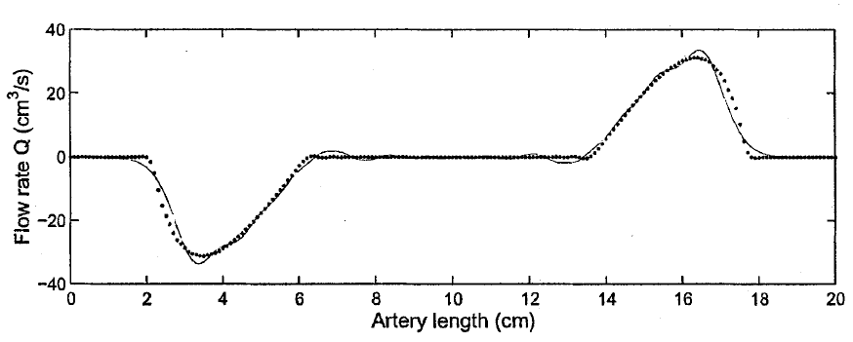
The BIG Picture of Differential Equations

Slide 10
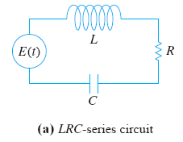
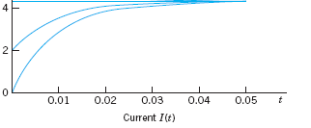
The BIG Picture of Differential Equations

Slide 11
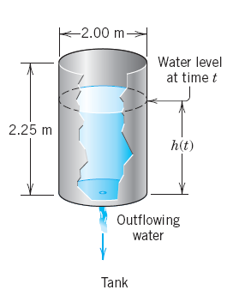
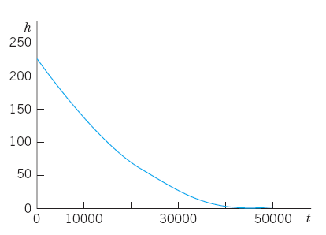

The BIG Picture of Differential Equations

Slide 12
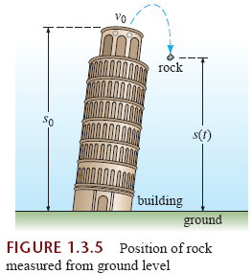
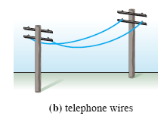

The BIG Picture of Differential Equations
Many other applications:

Slide 13



Differential Equations
Definitions:
An equation containing the derivatives of one or more dependent variables, with respect to one or more independent variables, is said to be a differential equation (DE).
Classification of differential equations: Classify by type, order, and linearity.

Slide 14





Differential Equations(DE)
CLASSIFICATION BY TYPE
A DE containing only ordinary derivatives of one or more dependent variables with respect to a single independent variable it is said to be an ordinary differential equation (ODE).
For example,
An equation involving partial derivatives of one or more dependent variables of two or more independent variables is called a partial differential equation (PDE).
● Leibniz notation: dy/dx, d²y/dx², .... and prime notation: y, y´, y´´,...

Slide 15

Differential Equations
CLASSIFICATION BY ORDER
The order of a differential equation (either ODE or PDE) is the order of the highest derivative in the equation
is a second-order ordinary differential equation.
In symbols we can express an nth-order ordinary differential equation in one
dependent variable by the general form
-(1)
where F is a real-valued function of n+2 variables: x, y, y’, y’’, . . . , y^{n}.
The degree of the DE is the power of its highest order derivative.
is second order but first degree.

Slide 16



Differential Equations
Classification by linearity:
An n-th order ordinary differential equation (1) is said to be linear if F is linear in
That means, that is of the form
Examples: Linear first order:
Linear second order:
...(2)
Two properties of a linear ODEs:
●The dependent variable y and all its derivatives are of the first degree.
●The coefficients a₀, a₁, . . . , a_{n} of depend at most on the independent variable x.
A nonlinear ordinary differential equation is simply one that is not linear.

Slide 17



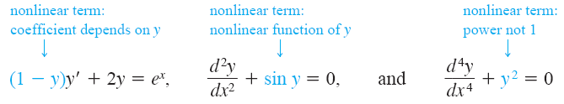
Differential Equations
Examples:
First order linear ODE:
Second order linear ODE:
Third order linear ODE:
Nonlinear first, second, and fourth order ODEs:

Slide 18


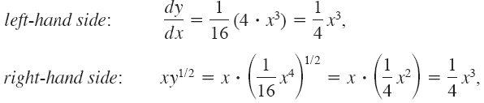
Differential Equations
Solutions of ODE:
where φ, is continuous function, satisfies the differential equation in (Eq-1) on some interval I.
Note: The domain of the solution of an ODE is valid in an open interval I=(a,b), closed interval I=[a,b], or, infinite interval (a, ∞) .
Verification of solutions: Verify the second eqn. is a solution of the first one.

Slide 19
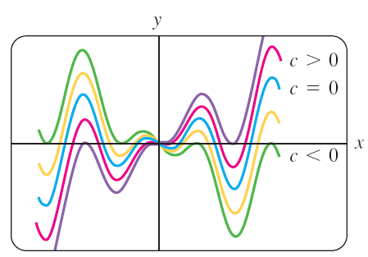
Differential Equations
Families of Solutions:
Solving a first-order differential equation F(x, y, y´ )= 0, we
usually obtain a solution containing a single arbitrary constant or parameter c, i.e.,
G(x, y, c)= 0
This is called one-parameter family of solutions.
When solving an nth-order differential equation F(x, y, y´, . . ., y^{n})=0, we seek an n-parameter family of solutions
G(x, y, c₁, c₂, . . . , c_{n})= 0.

Slide 20
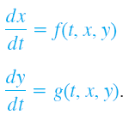
Differential Equations
Systems of Differential Equations:
A system of ordinary differential equations is two or more equations involving the derivatives of two or more unknown functions of a single independent variable.
A solution of the above system is a pair of differentiable functions x=φ₁(t), y= φ₂(t ), defined on a common interval I, that satisfy each equation of the system on this interval.

Slide 21



Differential Equations
Quiz Questions…..
Specify the order and degree of the ODE
Is that Linear/nonlinear
Verify y is a solution of the ODE in left side

Slide 22
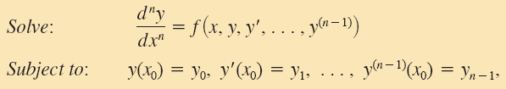
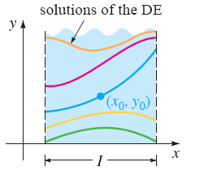

Differential Equations
Initial Value Problems(IVPs):
where y₀, y₁, . . . , y_{n-1} are arbitrary real constants, is called an nth-order initial-value problem (IVP). The values of y(x) and its first n-1 derivatives at x₀, y(x₀) = y₀, y´(x₀)= y1, . . . , y^{n-1}(x₀) =y_{n-1} are called initial conditions (IC).
Geometric Interpretation of IVPs:
For n=1,

Slide 23
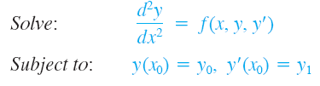
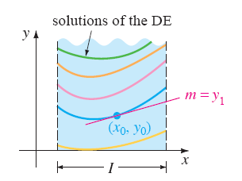
Differential Equations
Geometric Interpretation of IVPs:
For n=2,
Two boundary conditions

Slide 24
Differential Equations as Mathematical Models:
Mathematical Models:
The mathematical description of a system of phenomenon is called a mathematical model.
Construction of a mathematical model of a system starts with
(a) identification of the variables that are responsible for changing the system.
(b) make a set of reasonable assumptions, or hypotheses, about the
system we are trying to describe. These assumptions will also include any empirical laws that may be applicable to the system.

Slide 25
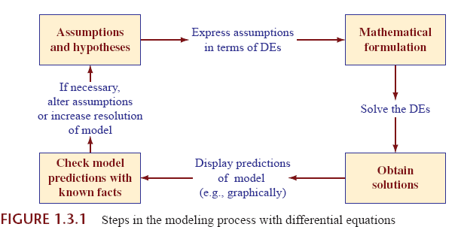
Differential Equations as Mathematical Models
The Modeling Process with ODE
Source: Dennis Zill. 10th edi. pp-21

Slide 26

Differential Equations
Differential Equations as Mathematical Models
Population Dynamics
Malthusian model is the assumption that the rate at which the population of a country grows at a certain time is proportional to the total population of the country at that time. In other words, the more people there are at time t, the more there are going to be in the future.
In mathematical terms, if P(t) denotes the total population at time t, then this assumption can be expressed as
where k is a constant of proportionality.

Slide 27


Differential Equations
Differential Equations as Mathematical Models
Newton’s Law of Cooling/Warming:
According to Newton’s empirical law of cooling/warming, the rate at which the temperature of a body changes is proportional to the difference between the temperature of the body and the temperature of the surrounding medium, the so-called ambient temperature.
If T(t) represents the temperature of a body at time t, T_{m} the temperature of the surrounding medium, and dT/dt the rate at which the temperature of the body changes, then Newton’s law of cooling/warming translates into the mathematical statement
where k is a constant of proportionality. In either case, cooling or warming, if T_{m} is a constant, it stands to reason that k<0.

Slide 28
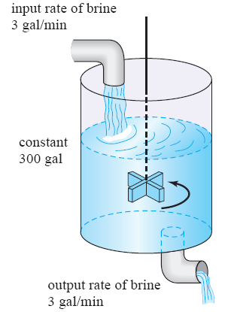
Differential Equations as Mathematical Models:
Mixture Problem
The mixing of two salt solutions of differing concentrations gives rise to a first-order differential equation for the amount of salt contained in the mixture.
Problem statement:
Let us suppose that a large mixing tank initially holds 300 gallons of brine. Another brine solution is pumped into the large tank at a rate of 3 gallons per minute; the concentration of the salt in this inflow is 2 pounds per gallon.
When the solution in the tank is well stirred, it is pumped out at the same rate as the entering solution.
Form a mathematical model for the above phenomena.

Slide 29
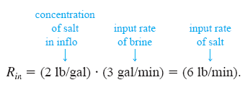
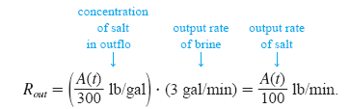
Differential Equations as Mathematical Models
If A(t) denotes the amount of salt (measured in pounds) in the tank at time t, then the rate at which A(t) changes is a net rate:
The input rate R_{in} at which salt enters the tank is the product of the inflow concentration of salt and the inflow rate of fluid
Since, the input and output rates are same, 300 gal brine remains constant at time t in the Tank.

Slide 30

Differential Equations as Mathematical Models
The net rate of change then becomes
If R_{in} and R_{out} is the input and output rates of the
brine solutions, then
case 1: If R_{in}= R_{out,} brine level in Tank is unchanged.
case 2: If R_{in} > R_{out}, the brine level increases.
case 3: If R_{in} < R_{out}, the brine level decreases.

Slide 31
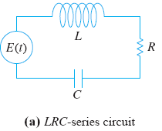


Differential Equations as Mathematical Models
Current passes through electric circuits:
Consider the single-loop LRC-series circuit. L, R, and C are known as inductance, resistance, and capacitance, respectively, and are generally constants.
The current in a circuit after a switch is closed is denoted by i(t); the charge on a capacitor at time t is denoted by q(t). E(t) is impressive voltage drop at time t.
According to Kirchhoff’s second law, respective voltage drops across an inductor, a capacitor, and a resistor, i.e.,
satisfy

Slide 32
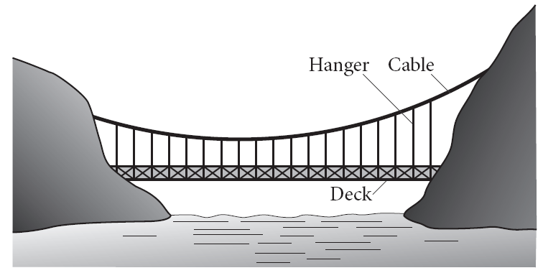
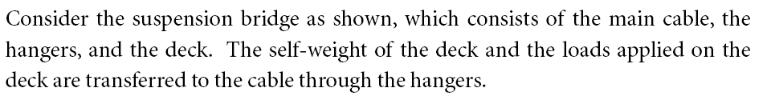
Motivating Example: Civil Engineering problem

Slide 33
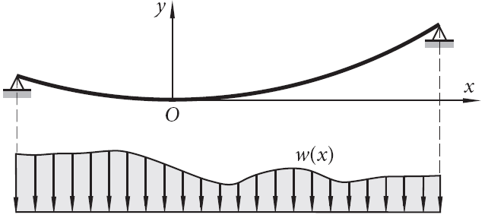
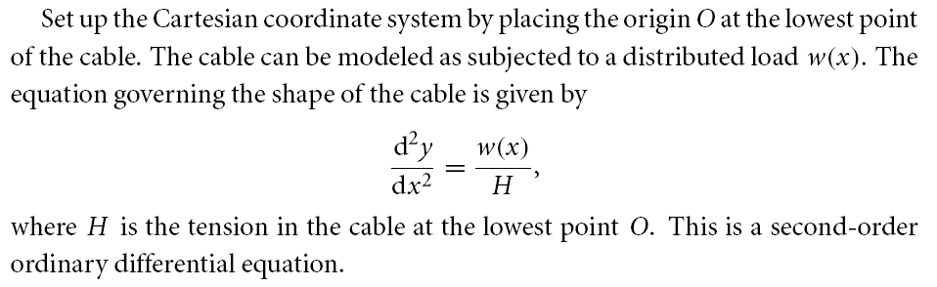
Release of force: Tension (H)
Distributed load: w(x)

Slide 34


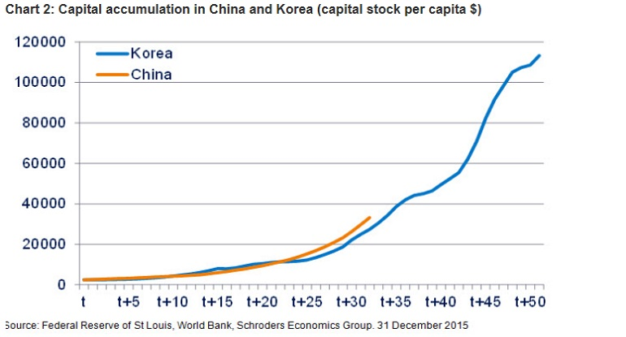
Motivating Example: Economics Problem-
The capital stock and investment
Capital accumulation:
Capital Stock= K(t)
Investment = I(t)

Slide 35


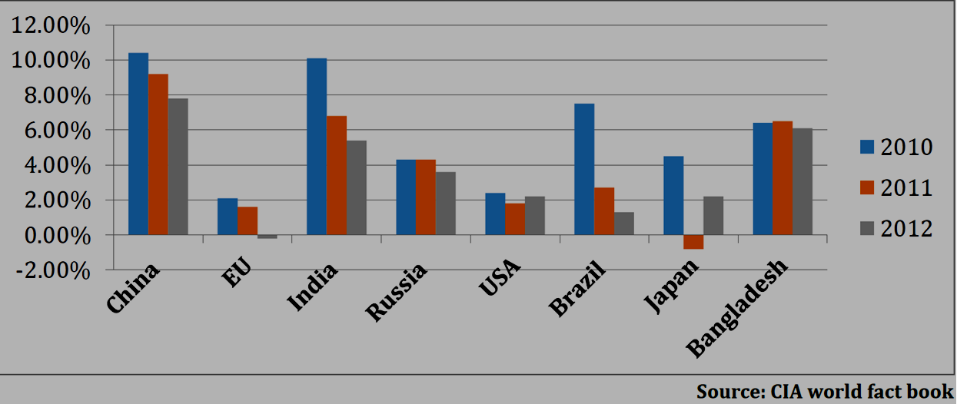
Motivating Example: Economics Problem-
Simple gross domestic product (GDP) model
The rate of change of the gross domestic product (GDP), x(t), over time
where t stands for time and g is the growth rate, at any point time t .
If g = g(x, t), then

Slide 36




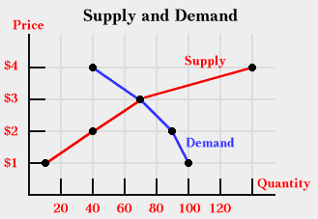



Motivating Example: Economics Problem-
Demand and supply model
where Q_{d} and Q_{s} are respectively the demand and supply for price P and a_{j} and b_{j} are parameters.
Assume that the rate of price change
with regard to time at t is proportional
to the excess demand, Q_{d} - Q_{s} , that is
m > 0
where,

Slide 37
Thank you

